Slide 1


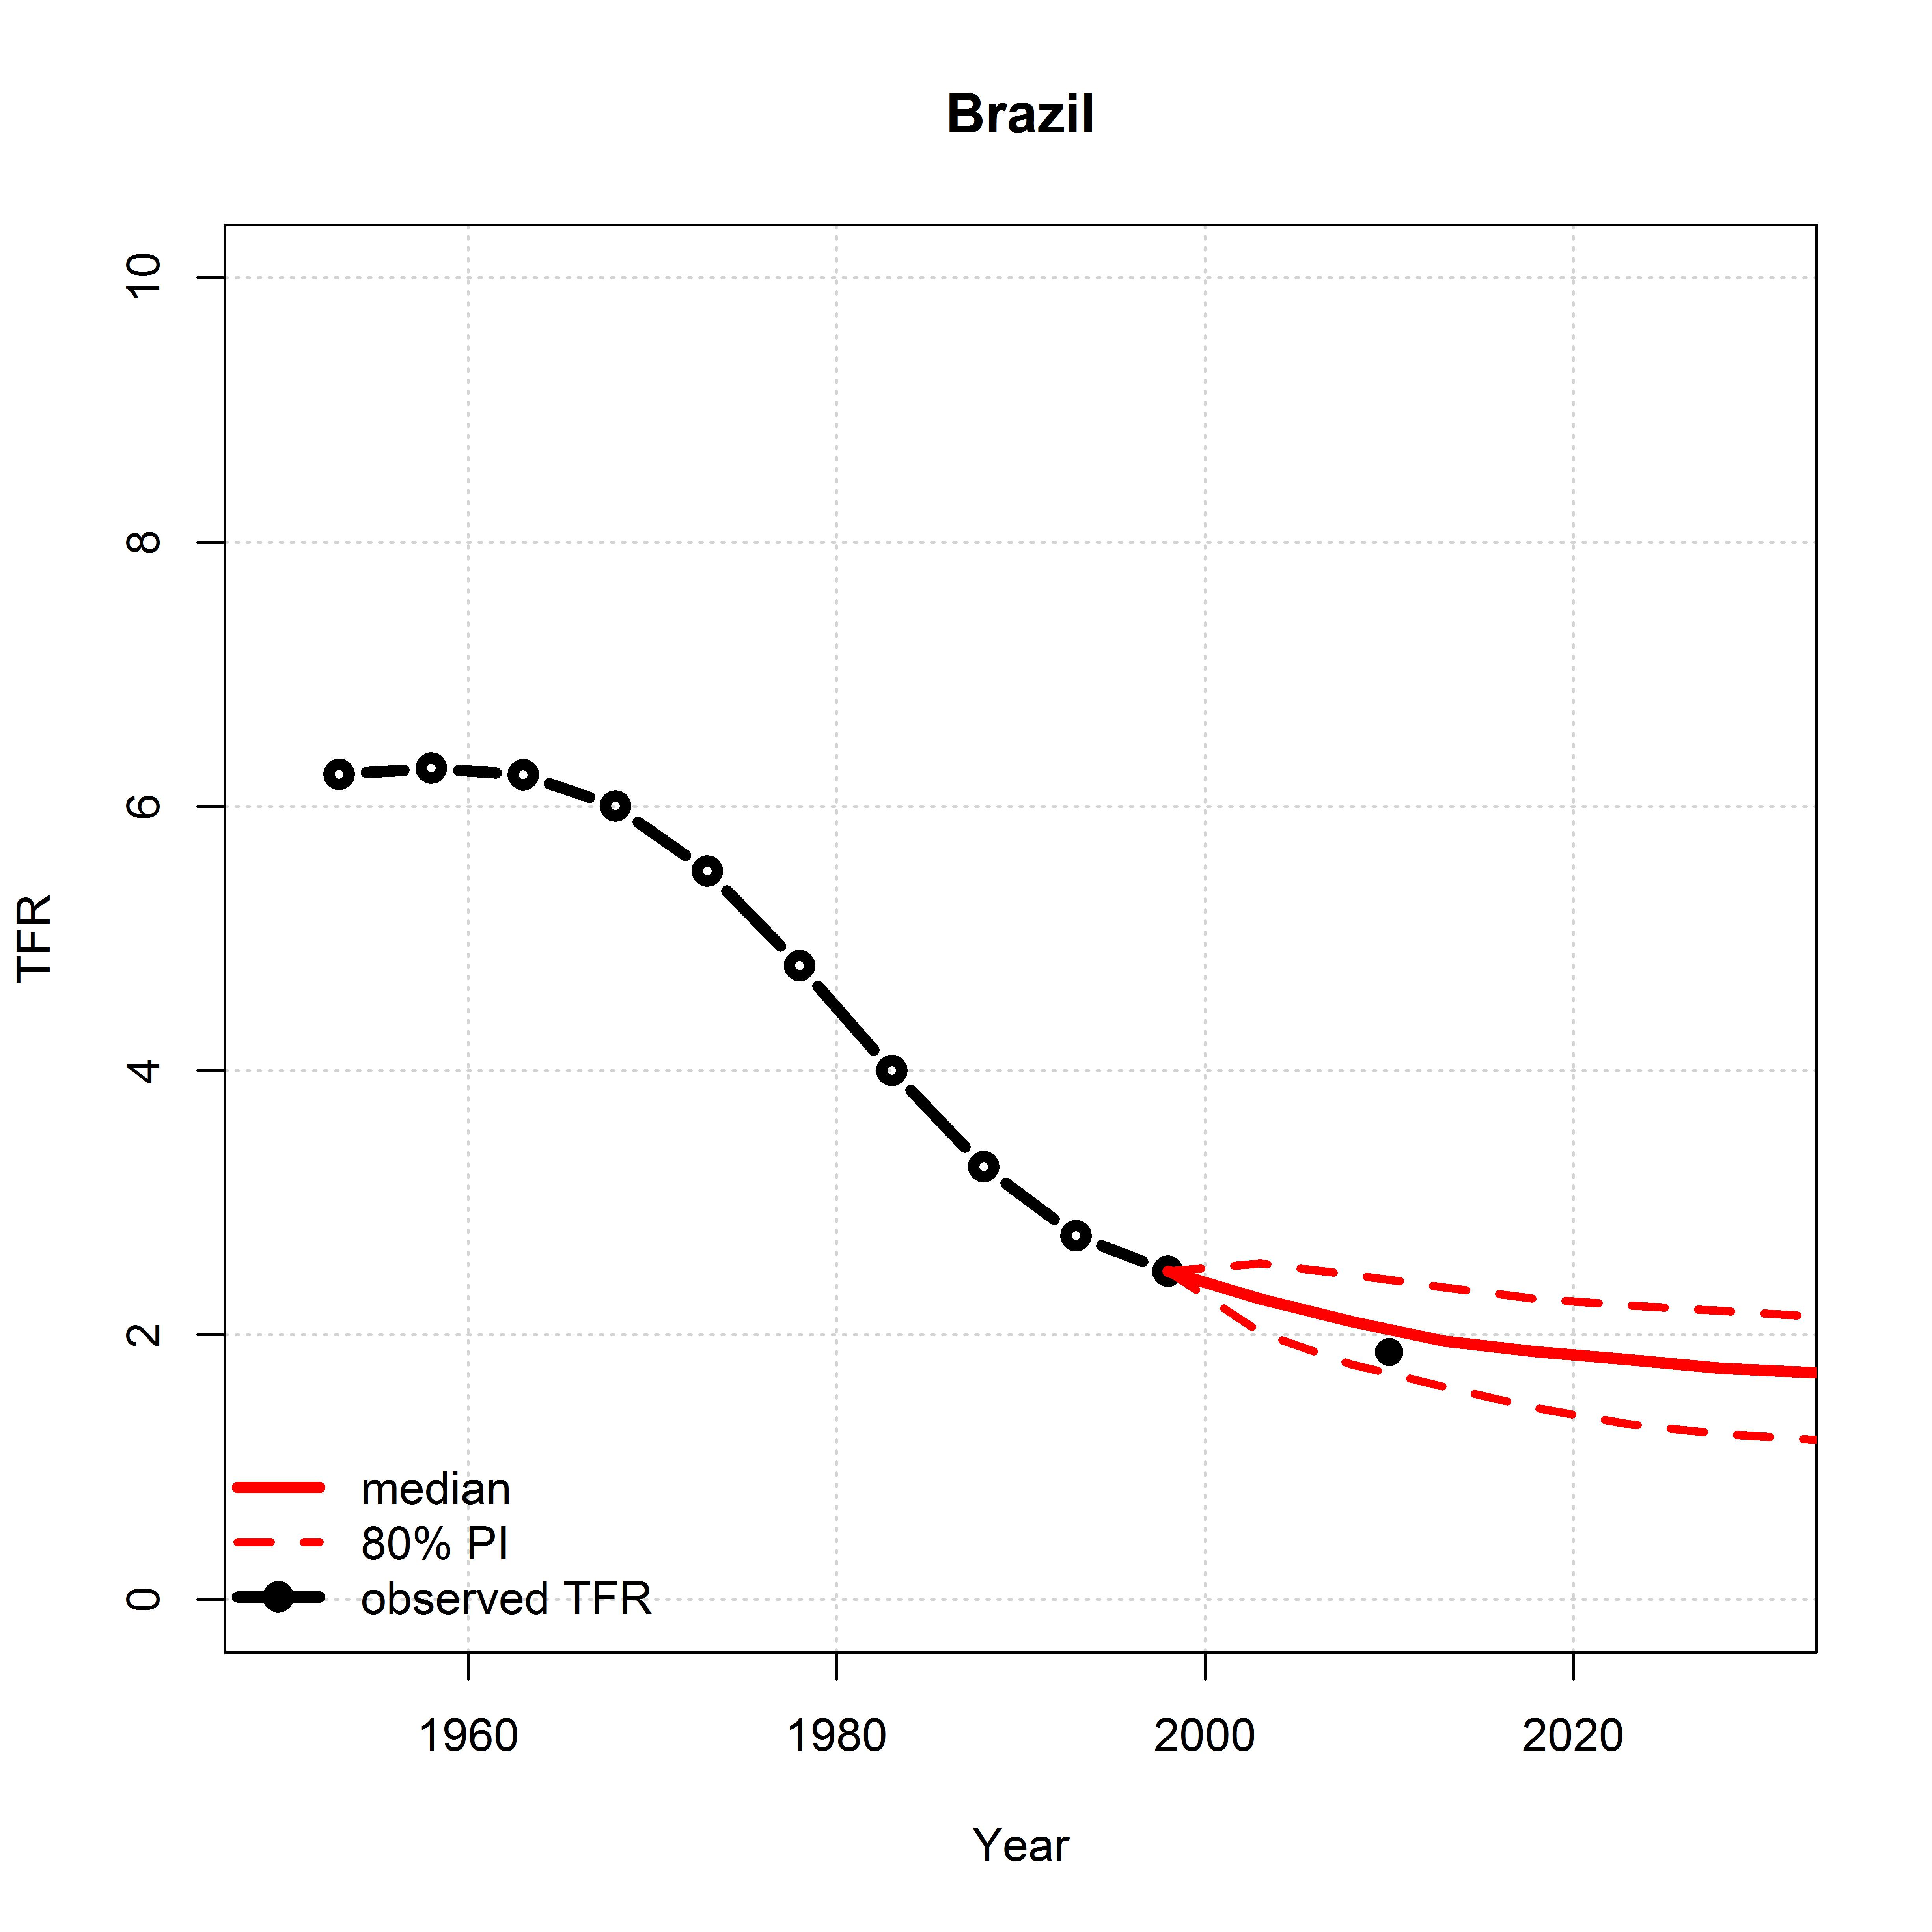
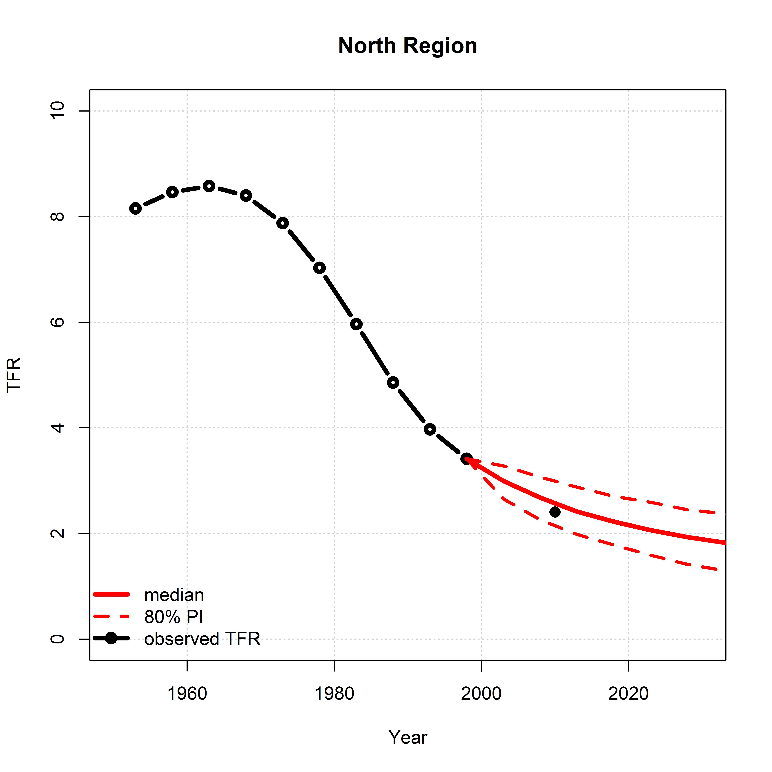
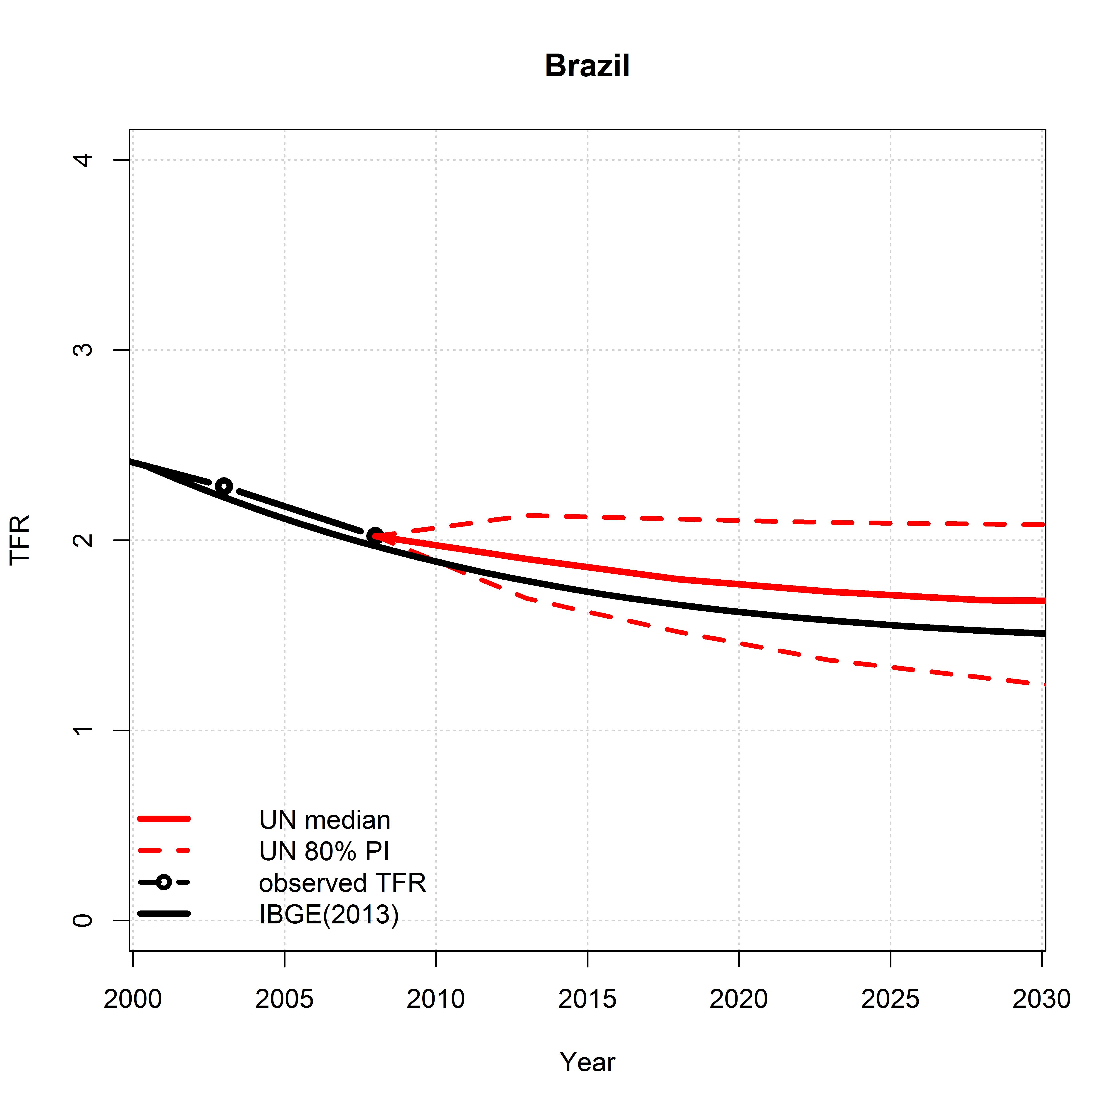
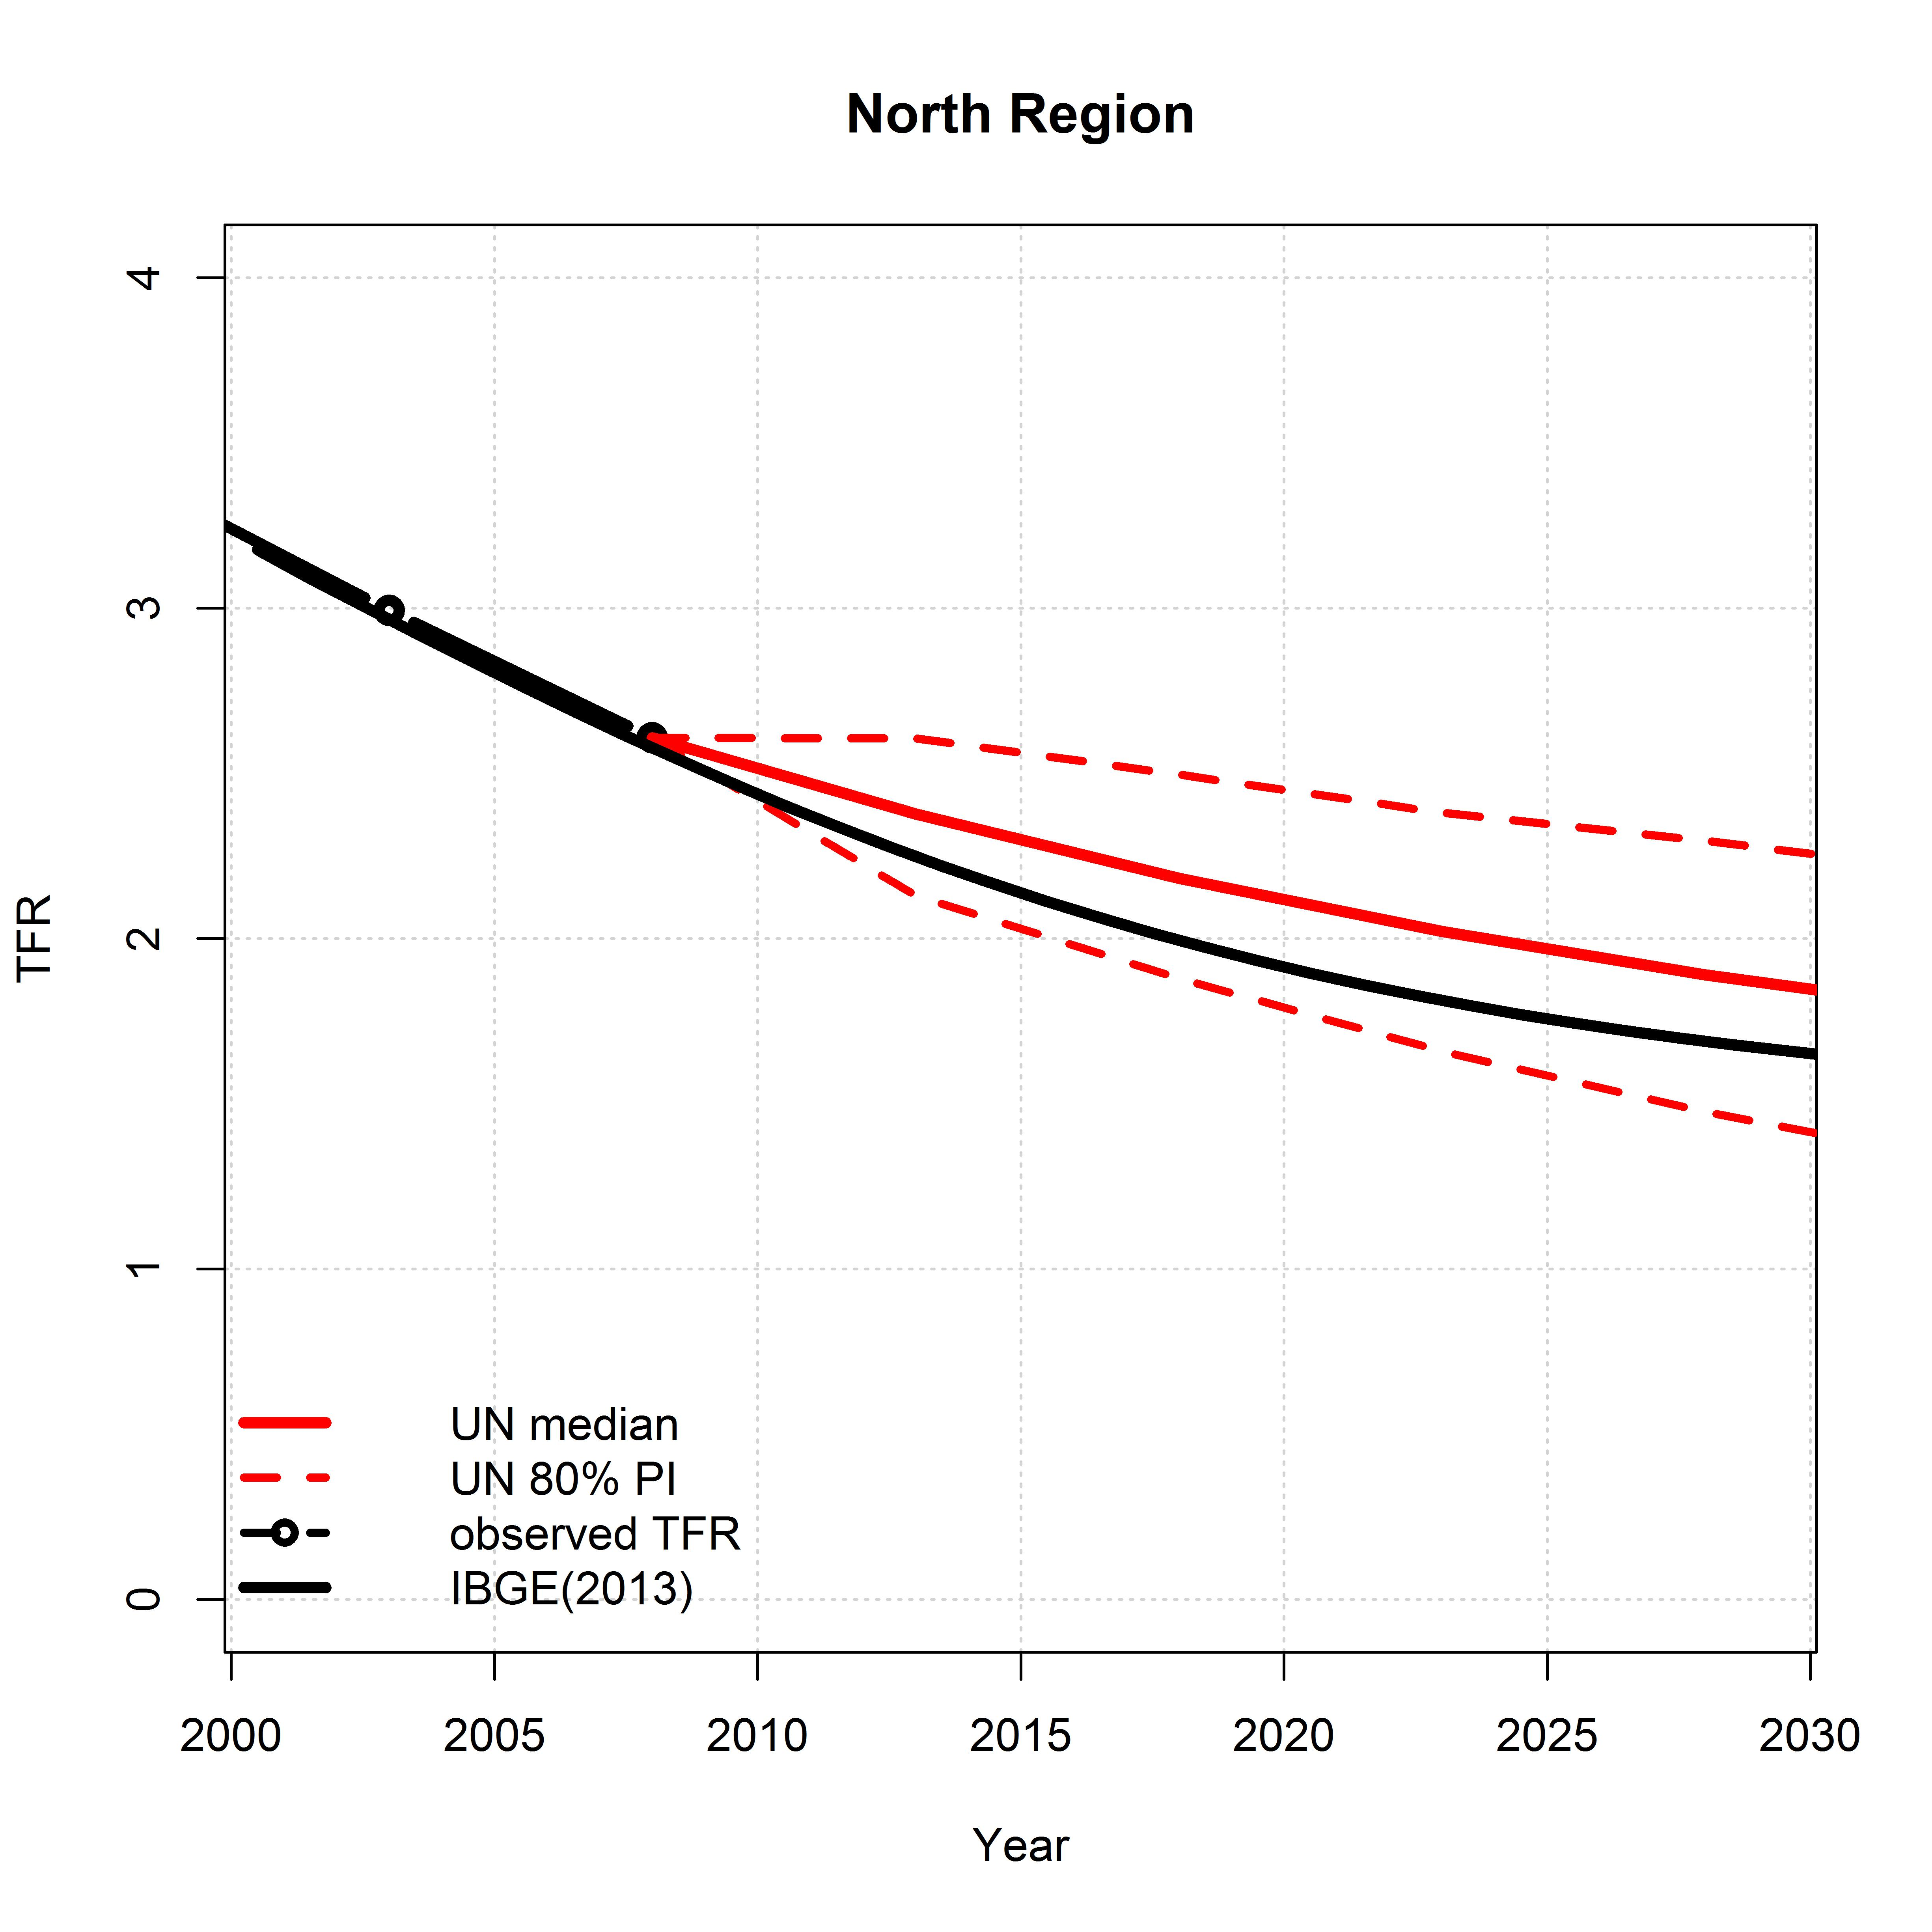
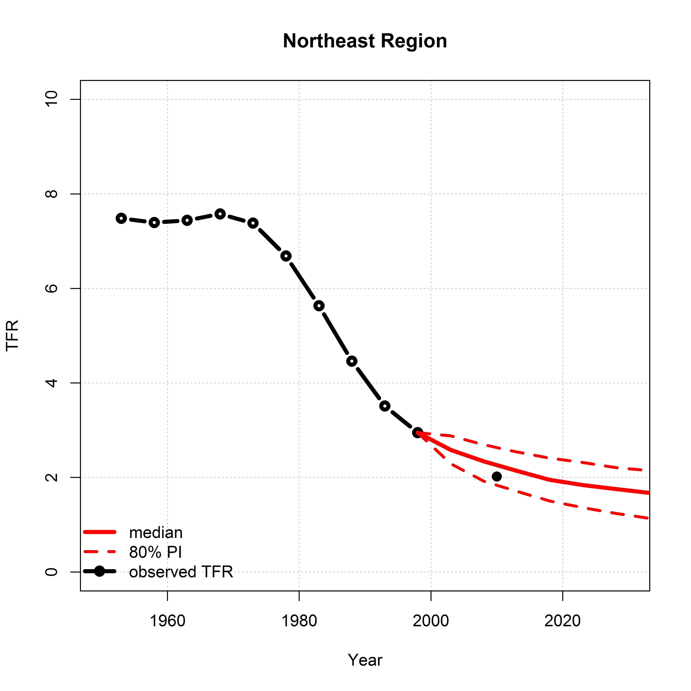
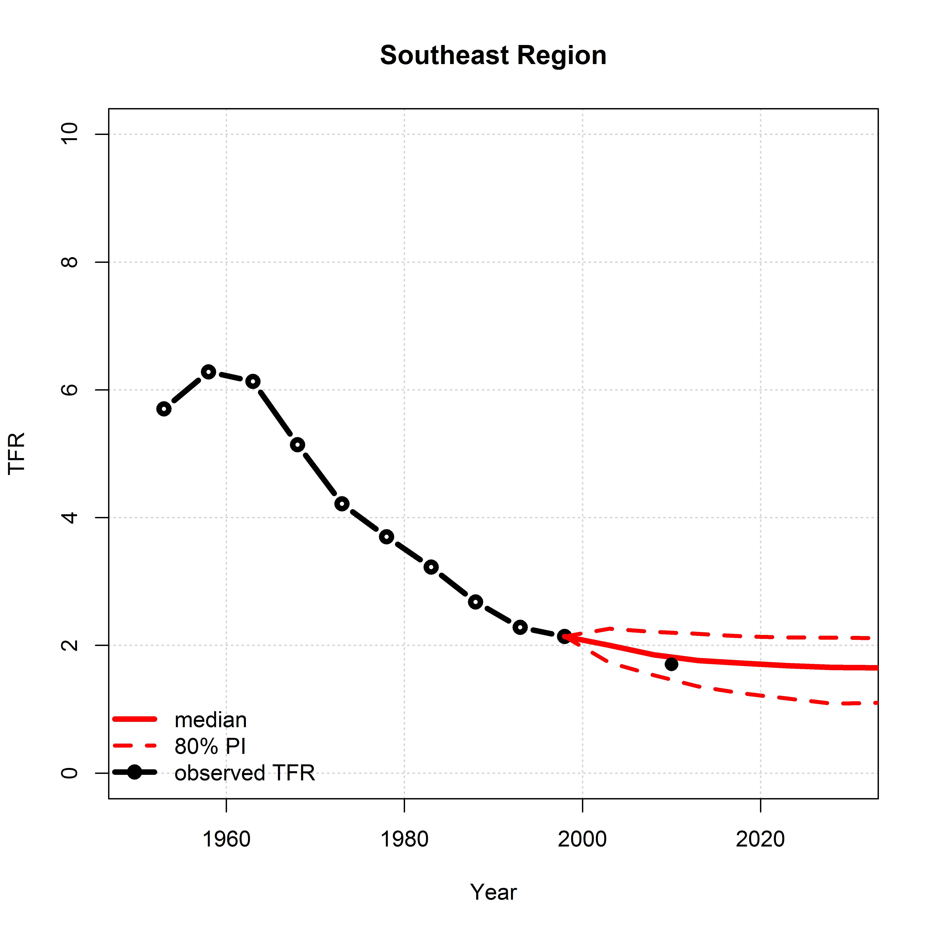
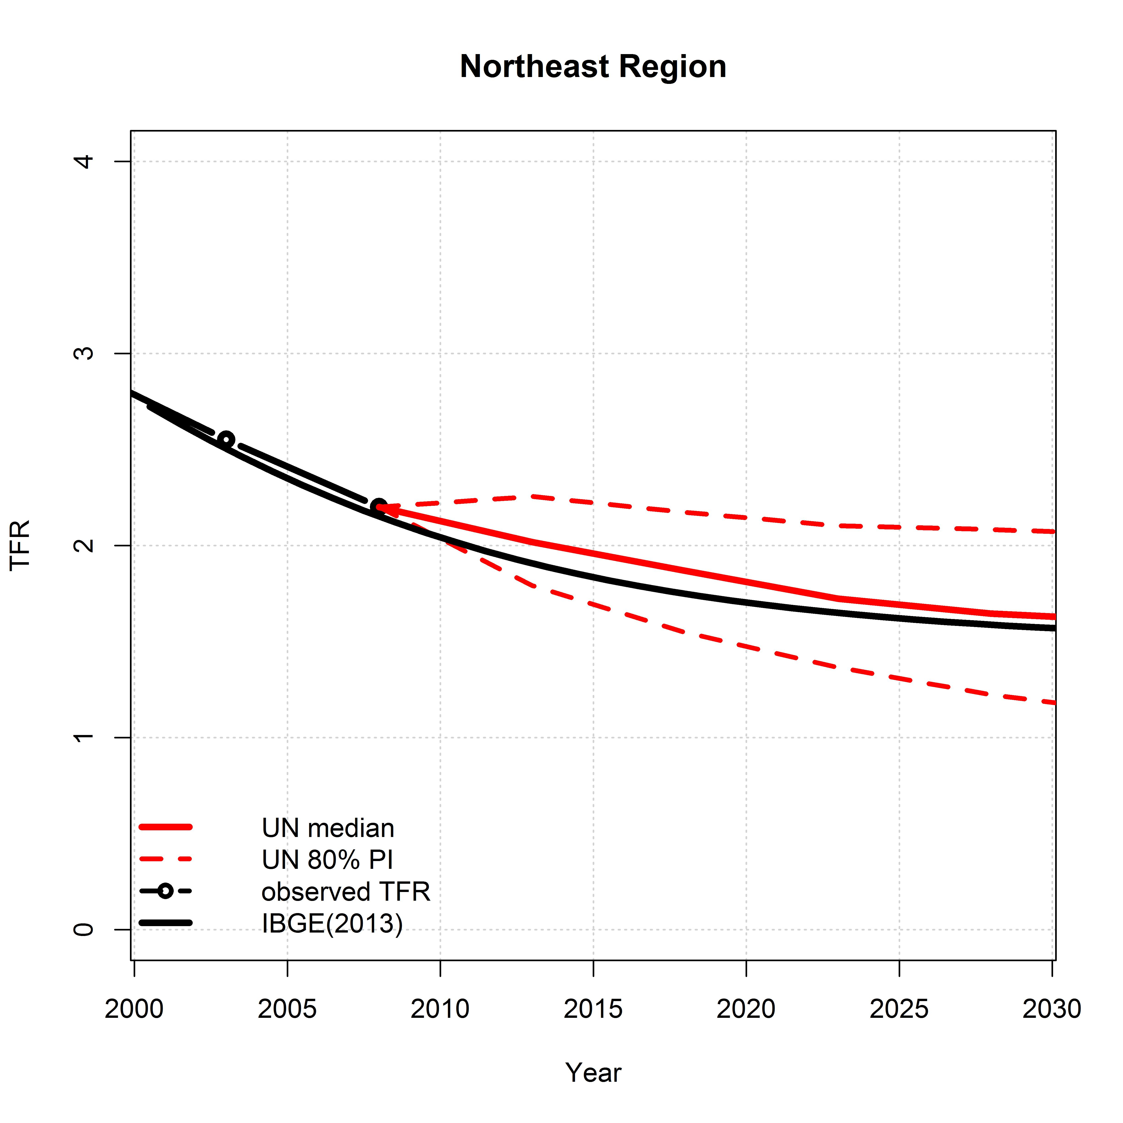
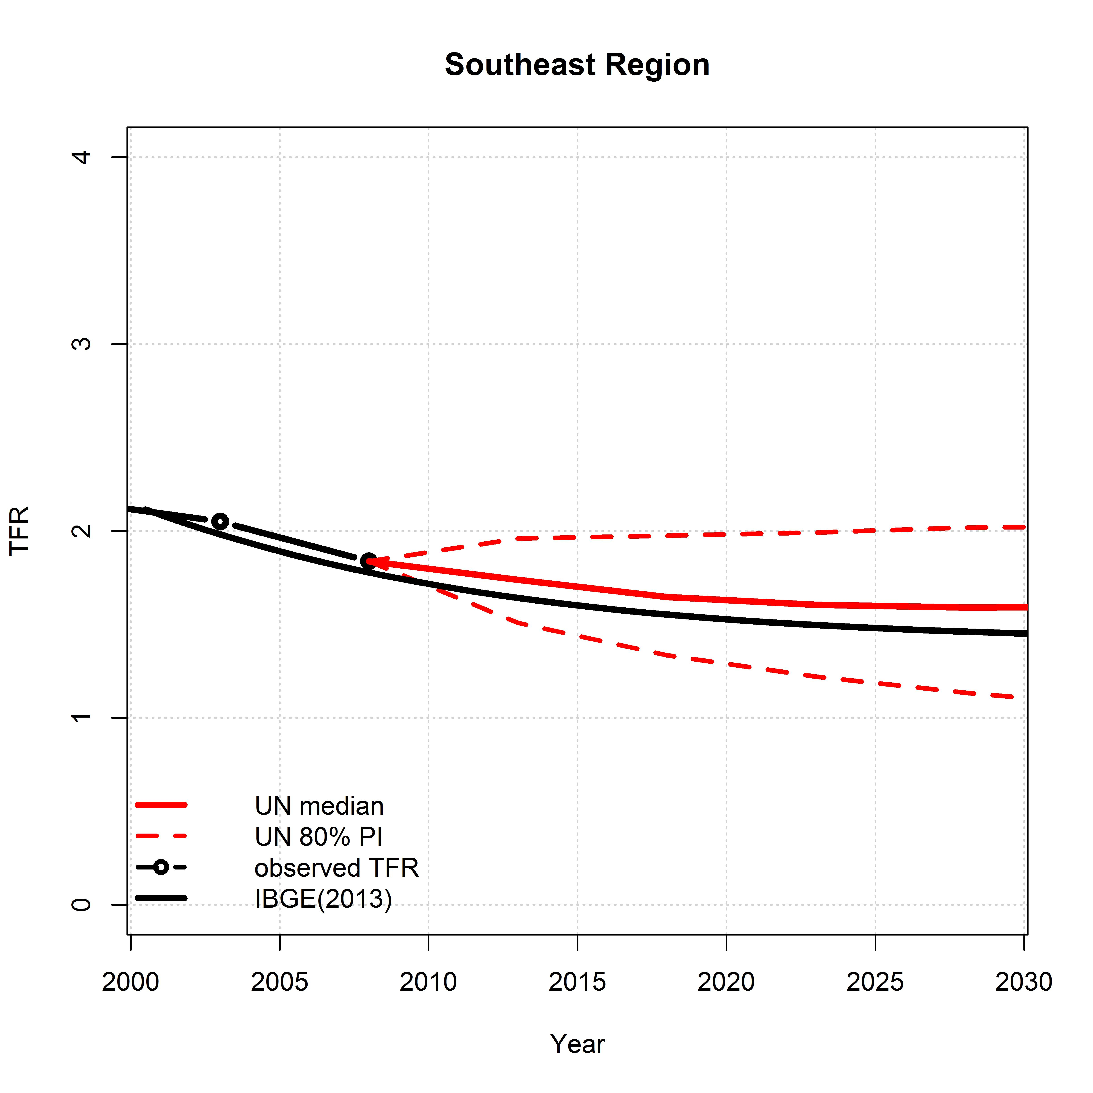
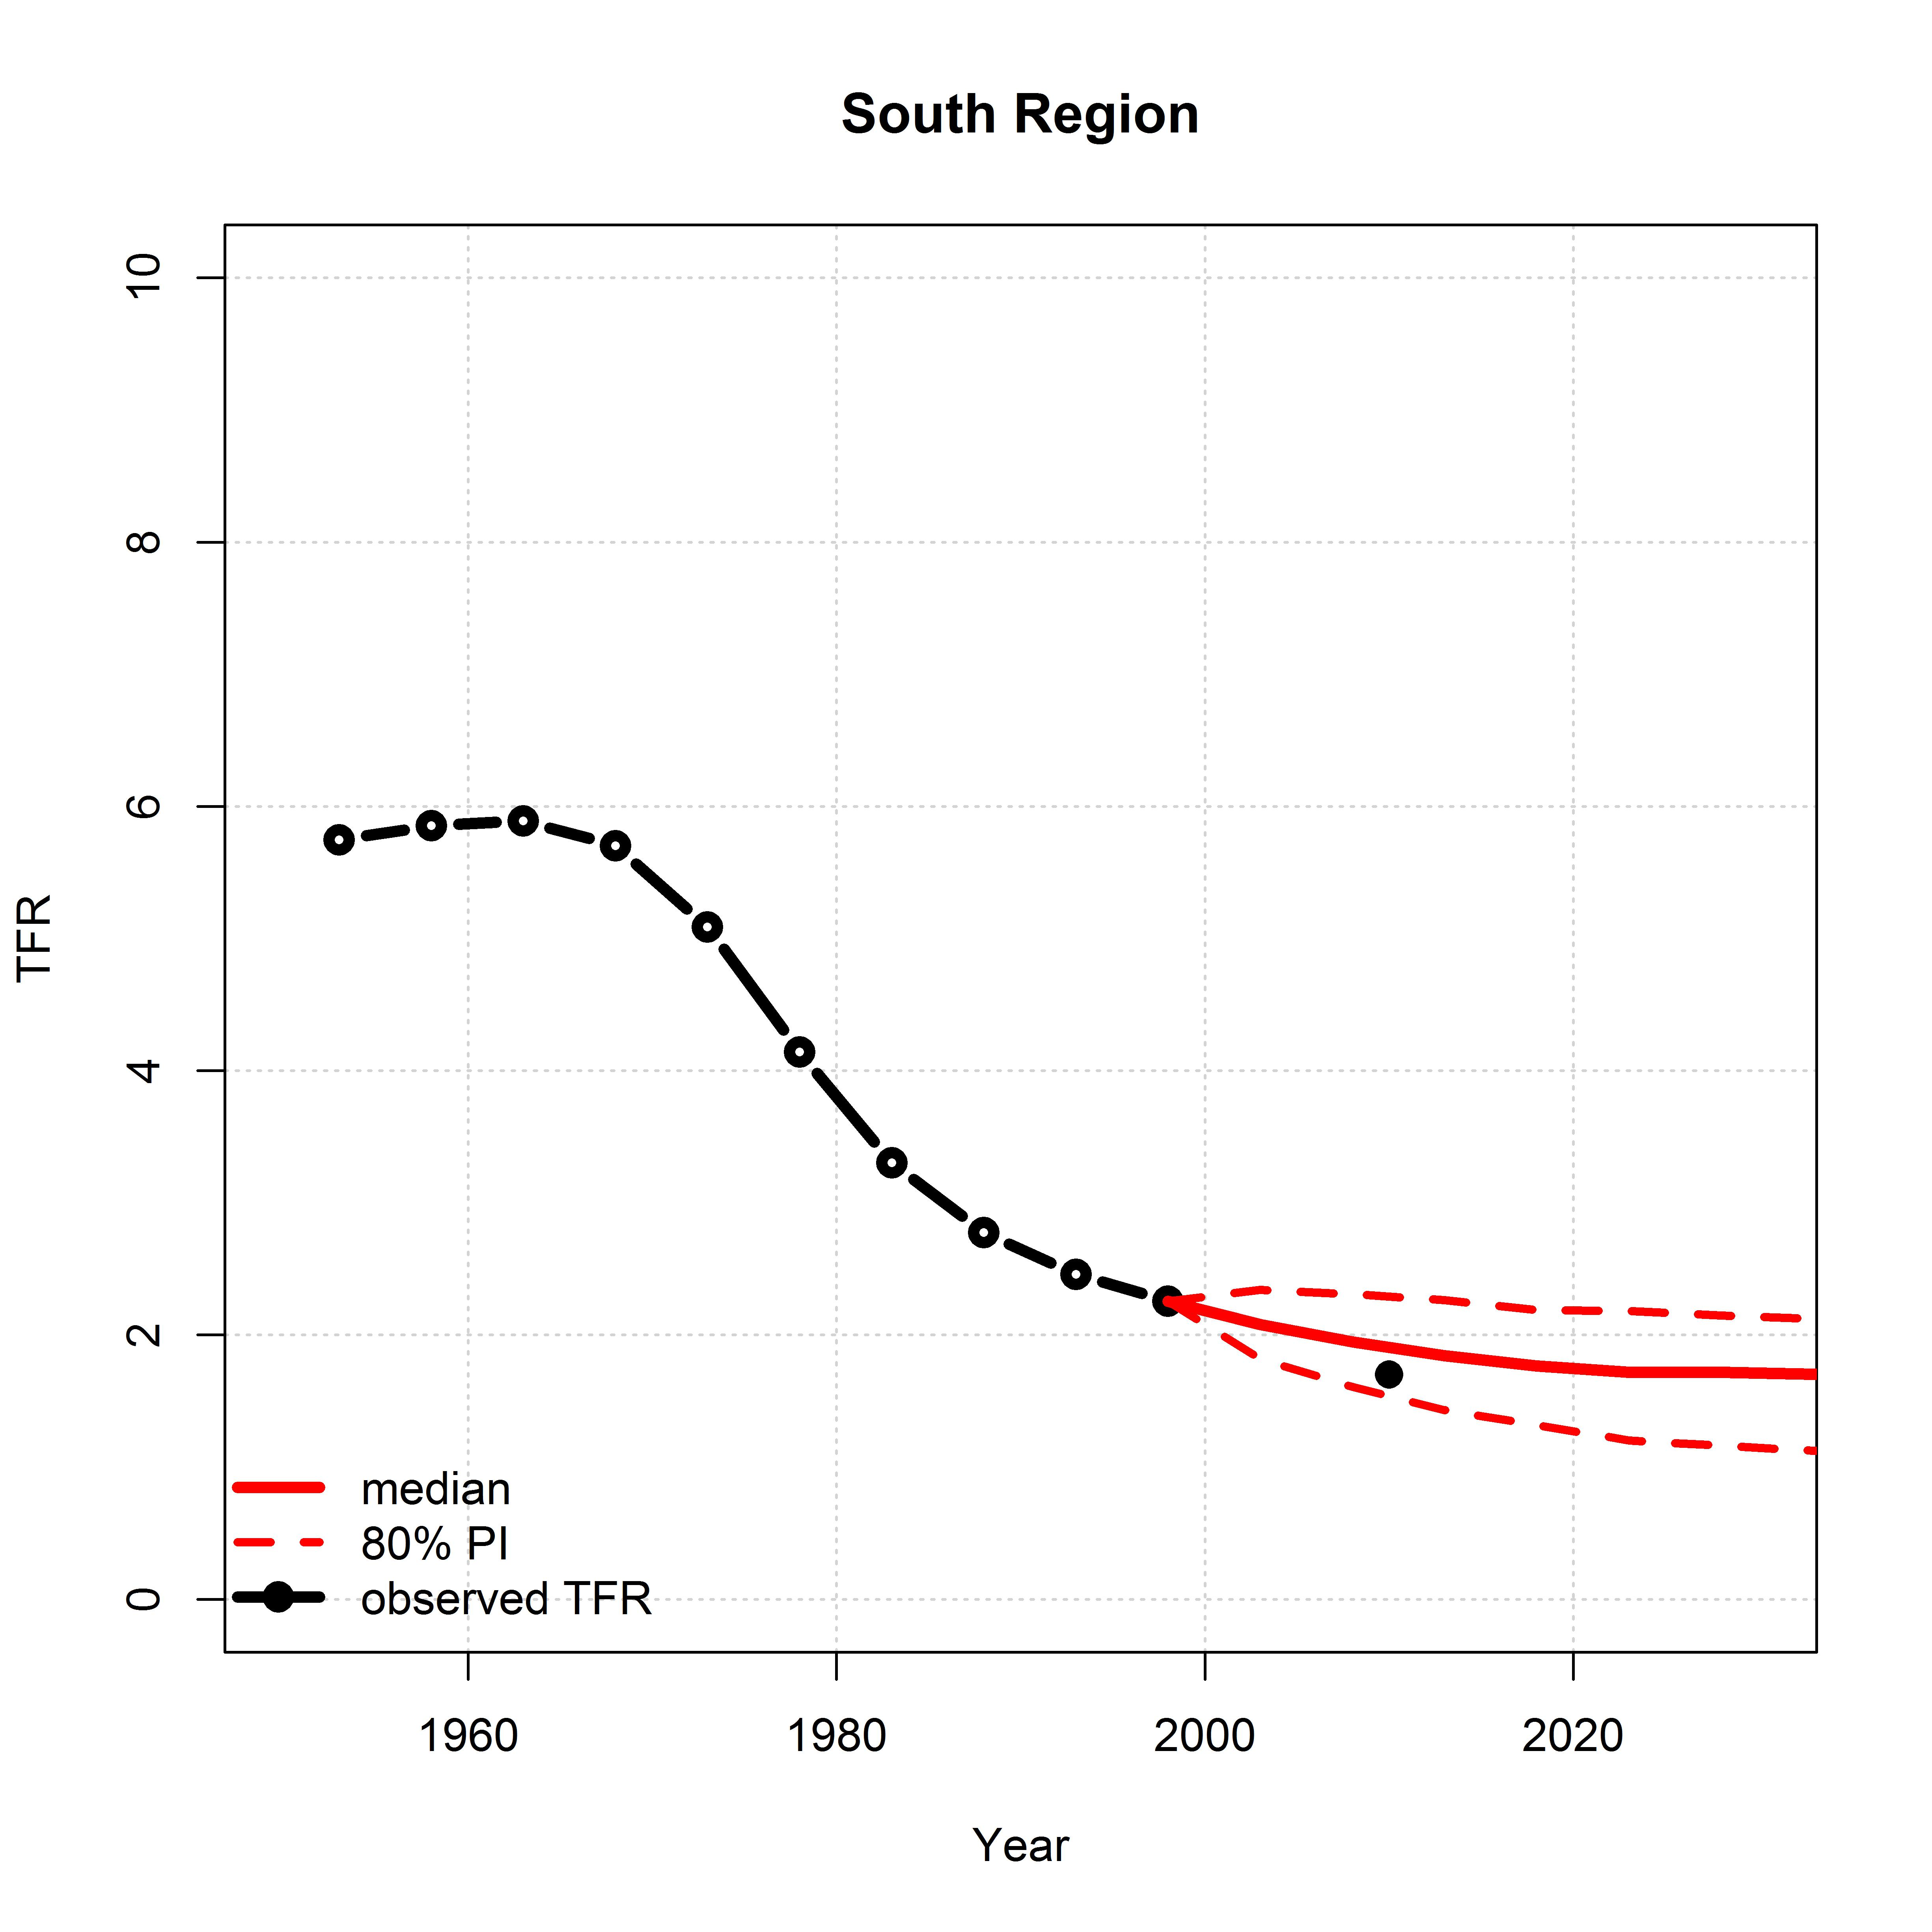
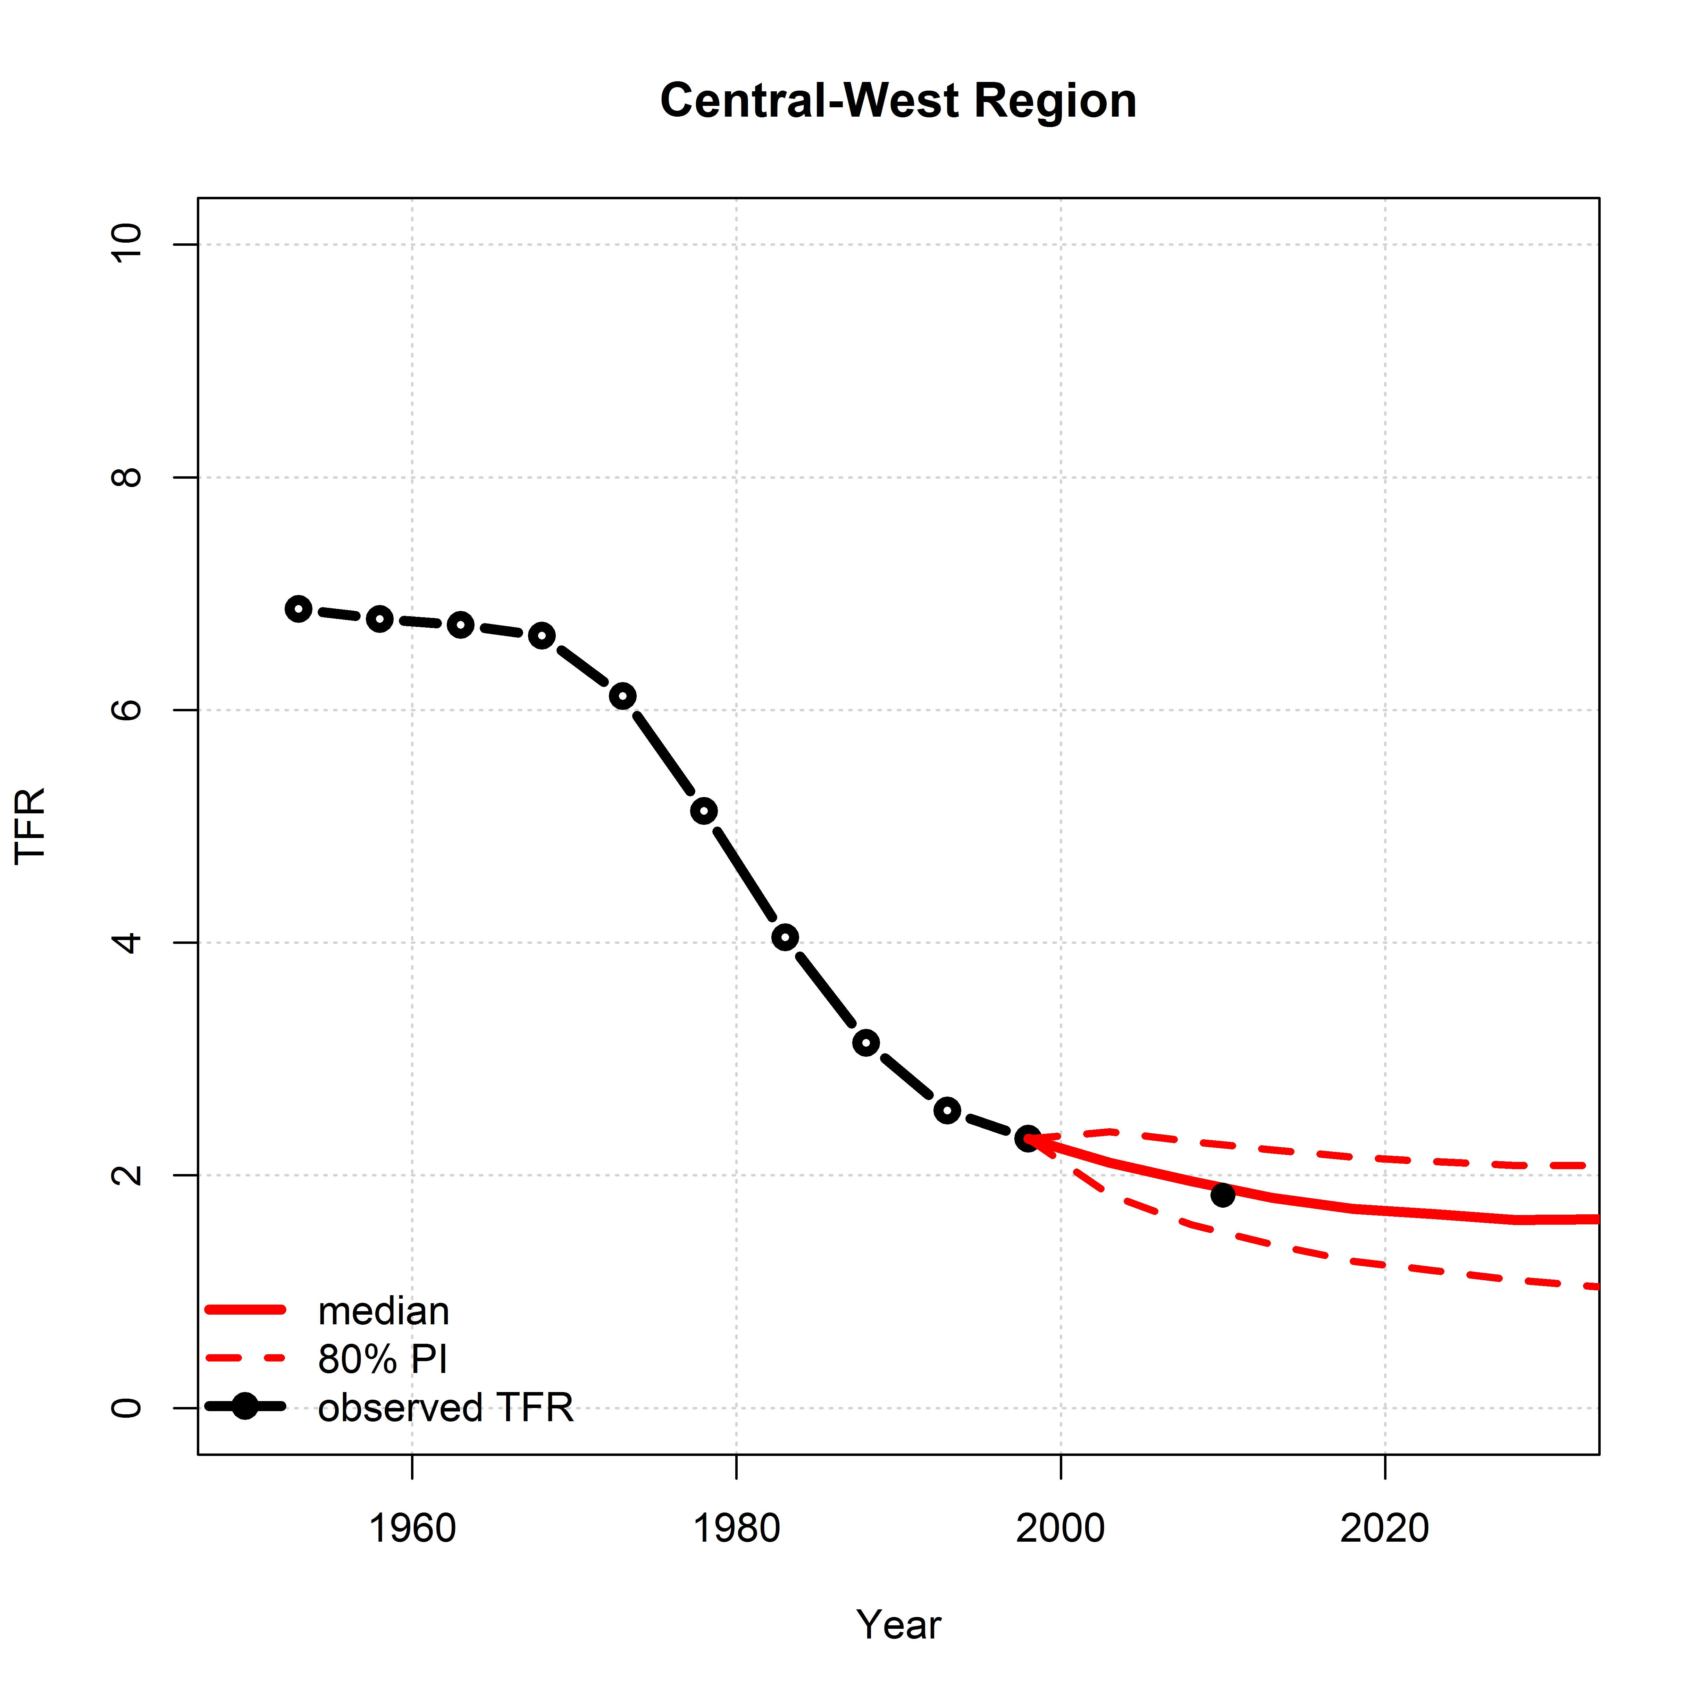
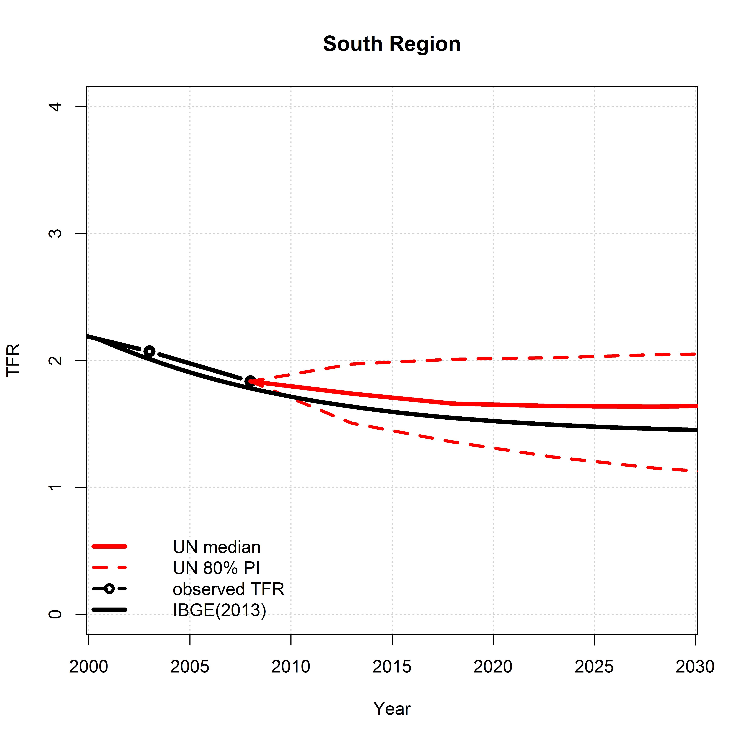
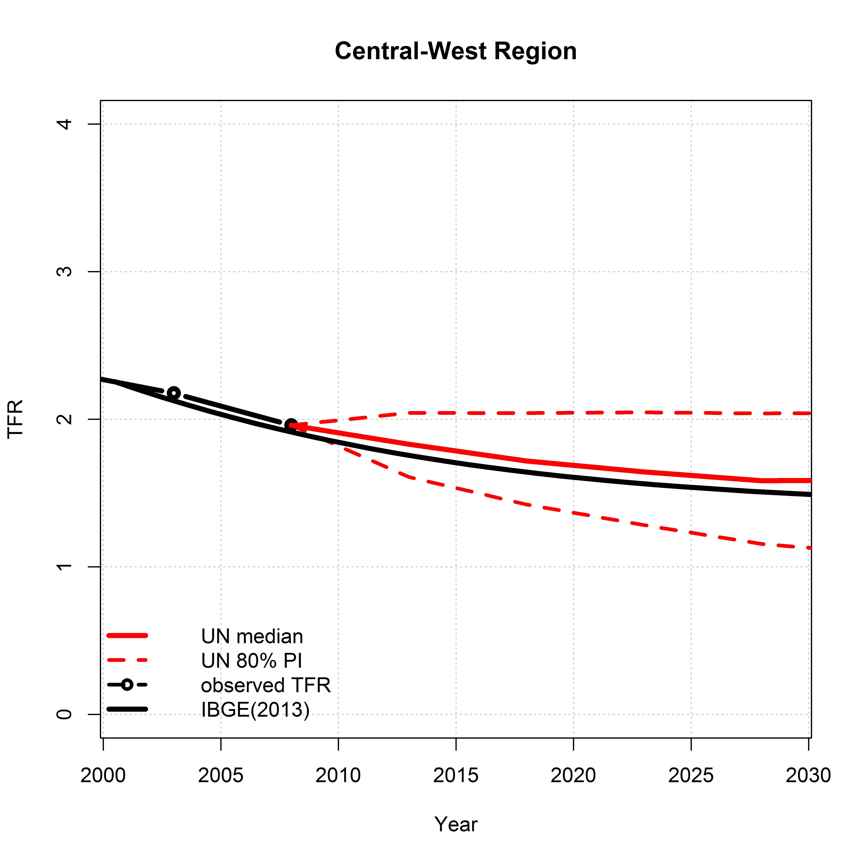
Subnational Fertility Projections in Brazil: a Bayesian Probabilistic Approach Application
Gabriel Mendes Borges
Instituto Brasileiro de Geografia e Estatística
Department of Demography - University of California, Berkeley
gmendesb@berkeley.edu
Abstract
The main objective of this paper is to project fertility rates for the sub-national levels in Brazil using the United Nations' (UN) Bayesian probabilistic approach in order to compare with the most recent fertility information and with the deterministic projection released by IBGE. Results show that out-of sample projections systematically overestimate the Total Fertility Rates (TFR) for 2010. For projections with starting point in 2010, IBGE’s estimations still present lower figures than those projected by the Bayesian model, in addition to a different convergence pattern in 2030.
Out-of-Sample Prediction and Recent Fertility Decline
Out-of-sample predictions show that projections systematically overestimate the TFR for 2010, even within the prediction intervals. Differences are greater in Northeast and South Regions, where projection overestimated fertility in more than 10%. Prediction for the Central-West Region is the closest to the TFR estimated by 2010. Projection intervals (80%) are relatively high, even for short-term projection. The difference between the upper and lower level is more than 0.8 children for the period 2010-2015. For 2030-2035 it is greater than 1.0 for all the Major Regions, but tend to be smaller for the country as a whole (Figure 1).
For the lower geographic levels there is also a tendency of the projections to overestimate the TFR in 2010 (Figure 2). Differences between projected and observed fertility are not associated with either the fertility or the socioeconomic levels of the regions. It depends on the decrements in TFR according to the fertility level. The function that models fertility implies decreasing decrements associated with lower levels of fertility, but most of the UFs actually accelerated the fertility decline in the last decade, reversing the historical trend. Even states who were already below the replacement-level presented a faster fertility decline.
From 2000 to 2010, Brazil experienced important social advancements, with sharp decline in inequality and poverty, major improvements in education and rapid infant mortality decline. Such social changes are very likely to be associated with the fertility decline. Thus, differences found between the predicted and observed values and more related to the unexpected fertility decline and the reversal of the decrement drop than to the goodness-of-fit of the model itself.
Projections: 2010-2030
Projections starting in 2010 show that IBGE’s estimations are always lower than those projected using the Bayesian probabilistic approach. Central-West and Northeast Regions present similar figures, while important differences arise in the North Region. In the most developed regions, South and Southeast, Bayesian estimations project certain stability in fertility rates (around 1.6) during the 2020s, which precedes the future recovery, while IBGE project a limit of 1.45 (Figure 3).
Results for the UFs show that fertility projected by IBGE present the regional convergence in different groups varying from 1.45 to 1.75, while projections using the Bayesian model result in a more heterogeneous distribution, ranging from 1.4 to 2.1 children per women (Figure 4).
IBGE’s projections also show a clearer association between fertility and current social economic level of the regions. UFs with higher income and level of education tend to present lower fertility levels in 2030, while the states in the poorest regions present higher fertility. Projections based on UN Bayesian model leads to a more disperse relationship between these variables.
Introduction
Population projections are a fundamental part of understanding the future of human population, being broadly used in planning and monitoring public policies and private decisions. In Brazil, they are also used in funding allocations to states and municipalities, sample surveys expansions, in addition to serving as the denominators for the calculation of several indicators. Therefore, demand is increasing for subnational level projections. Fertility is a very sensitive variable in modifying the population size and structure. Hence, important for population projection accuracy are fertility estimations, which constitute a challenge, since they involve high levels of uncertainty.
Population projections in Brazil, with rare exceptions, have underestimated fertility decline since the 1970’s. More recently, in the beginning of the 2000s, most of the official projections performed by IBGE, CELADE and the UN still estimate Brazilian fertility above replacement level.
However, fertility has declined more rapidly in Brazil than we would have expected from the above projections, with the TFR reducing from more than 6 children per woman in 1960 to less than 2 in 2010. Although the decline has been generalized, the timing and intensity varies geographically and across populational subgroups.
Discussion and Conclusions
Bayesian probabilistic approach offers a promising alternative to sub-national level projections in Brazil, providing less arbitrary point estimations and, most importantly, measures of uncertainty. Furthermore, while IBGE projections suppose that fertility falls monotonically, UN's method, based on the experiences of other countries, assumes recovery from below-replacement fertility.
On the other hand, UN’s method models fertility decline based on the decrement of the TFR according to the fertility level. Particularities of the Brazilian fertility transition in regional levels, with sharper decline than in most of the other countries, combined with a very high concentration of fertility among young women, could lead to imprecisions in fertility projections. In this sense, understanding the fertility schedule and the roles of the quantum and tempo effects are central part of fertility projections in Brazil.
Moreover, consideration of inequalities in the country, especially in terms of income and education, can support the projections, even though it is very hard to incorporate them in the models, especially due the difficulty in projecting these variables.
Future works could also try to use regions that have closer characteristics to the Brazilian context, other than the level and the decrement of fertility decline, in order to estimate the parameters. Latin-American countries which have similar cultural and socioeconomic characteristics in addition to a closer fertility age-structure are potential candidates.
Material and Methods
TFR for Brazil, Major Regions and Units of the Federation (UFs) come from IBGE’s estimation using indirect techniques for every decennial Census from 1940 to 2010. Information for all countries used to perform the Bayesian probabilistic projection derives from the 2012 Revision of the World Population Prospects (DeSA, 2013).
IBGE only released its first official projections for the UFs using the cohort-component method in 2013. Fertility rates were projected using logistic interpolations of the TFR from 2000 to 2010 and an extrapolation of these rates until 2030, considering limits that vary according to the characteristics of each UF. The intrinsic assumption is that fertility will keep falling, and there will be a regional, but not national, convergence in the future (IBGE, 2013).
Until recently, the UN has used deterministic approaches to estimate future fertility. Alkema et al. (2011) propose a Bayesian method to produce TFR projections for all countries based on historic TFR trends. Ševcıková and Gerland (2013) encourage the application of this method to subnational datasets. The method includes three phases: pre-transitional high fertility; fertility transition from high to replacement level or below; and a post-transition low fertility, which includes recovery from below-replacement levels and oscillations around replacement levels.
Figure 1 - Total Fertility Rates observed (1950-2000 and 2010) and projected (2000-2030) - Brazil and Major Regions
Figure 3 - Total Fertility Rates projected by the UN method, with 80% intervals, and IBGE - Brazil and Major Regions, 2000-2030
References
Alkema, L., Raftery, A.E., Gerland, P., Clark, S.J., Pelletier, F., Buettner, T., and Heilig, G.K. (2011). Probabilistic Projections of the Total Fertility Rate for All Countries. Demography 48, 815–839.
IBGE (2013). Projeções da População: Brasil e Unidades da Federação (Rio de Janeiro: COPIS - IBGE).
DeSA, U. (2013). World population prospects: The 2012 revision. Popul. Div. Dep. Econ. Soc. Aff. U. N. Secr. N. Y.
Ševcıková, H., and Gerland, P. (2013). Bayesian probabilistic population projections: do it yourself. paper presented at the Joint Eurostat/UNECE Work Session on Demographic Projections, Rome, Italy, 29 to 31 October 2013
Figure 2. Total Fertility Rates projected and observed by Units of the Federation in 2010
Figure 4 - Total Fertility Rates projected by the UN method and IBGE – Units of the Federation, 2000-2030

